Slide 1
Bayesian Networks
  Material used
  Halpern: Reasoning about Uncertainty. Chapter 4
  Stuart Russell and Peter Norvig: Artificial Intelligence: A Modern Approach
  1 Random variables
  2 Probabilistic independence
  3 Belief networks
  4 Global and local semantics
  5 Constructing belief networks
  6 Inference in belief networks

Slide 2
1 Random variables
Suppose that a coin is tossed five times. What is the total number of heads?
Intuitively, it is a variable because its value varies, and it is random because its value is unpredictable in a certain sense
Formally, a random variable is neither random nor a variable
Definition 1: A random variable X on a sample space (set of possible worlds) W is a function from W to some range (e.g. the natural numbers)

Slide 3
Example
A coin is tossed five times: W = {h,t}⁵.
NH(w) = |{i: w[i] = h}| (number of heads in seq. w)
NH(hthht) = 3
Question: what is the probability of getting three heads in a sequence of five tosses?
μ(NH = 3) =_{def} μ({w: NH(w) = 3})
μ(NH = 3) = 10 ⋅2⁻⁵ = 10/32

Slide 4
Why are random variables important?
They provide a tool for structuring possible worlds
A world can often be completely characterized by the values taken on by a number of random variables
Example: W = {h,t}⁵, each world can be characterized
  by 5 random variables X₁, …X₅ where X_{i} designates the outcome of the ith tosses: X_{i}(w) = w[i]
  an alternative way is in terms of Boolean random variables, e.g. H_{i}: H_{i}(w) = 1 if w[i] = h, H_{i}(w) = 0 if w[i] = t.
  use the random variables H_{i}(w) for constructing a new random variable that expresses the number of tails in 5 tosses

Slide 5
2 Probabilistic Independence
If two events U and V are independent (or unrelated) then learning U should not affect he probability of V and learning V should not affect the probability of U.
Definition 2: U and V are absolutely independent (with respect to a probability measure μ) if μ(V) ≠ 0 implies μ(U|V) = μ(U) and μ(U) ≠ 0 implies μ(V|U) = μ(V)
Fact 1: the following are equivalent
a. μ(V) ≠ 0 implies μ(U|V) = μ(U)
b. μ(U) ≠ 0 implies μ(V|U) = μ(V)
c. μ(U ∩ V) = μ(U) μ(V)

Slide 6
Absolute independence for random variables
Definition 3: Two random variables X and Y are absolutely independent (with respect to a probability measure μ) iff for all x∈ Value(X) and all y∈ Value(Y) the event X = x is absolutely independent of the event Y = y.
Notation: I_{μ}(X,Y)
Definition 4: n random variables X₁ … X_{n} are absolutely independent iff for all i, x₁, …, x_{n}, the events X_{i}= x_{i} and ∩_{j≠i}(X_{i}=x_{i}) are absolutely independent.
Fact 2: If n random variables X₁ …X_{n} are absolutely independent then μ(X₁= x₁, X_{n}= x_{n} ) = Π_{i} μ(X_{i}= x_{i}).
Absolute independence is a very strong requirement, seldom met

Slide 7
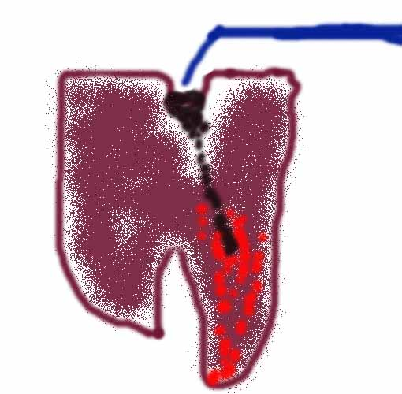
Conditional independence: example
Example: Dentist problem with three events:
Toothache (I have a toothache)
Cavity (I have a cavity)
Catch (steel probe catches in my tooth)
If I have a cavity, the probability that the probe catches in it does not depend on whether I have a toothache
i.e. Catch is conditionally independent of Toothache given Cavity: I_{μ}(Catch, Toothache|Cavity)
μ(Catch|Toothache∩Cavity) = μ(Catch|Cavity)

Slide 8
Conditional independence for events
Definition 5: A and B are conditionally independent given C if μ(B∩C) ≠ 0 implies μ(A|B∩C) = μ(A|C) and
μ(A∩C) ≠ 0 implies μ(B|A∩C) = μ(B|C)
Fact 3: the following are equivalent if μ(C) ≠ 0
  μ(A|B∩C) ≠ 0 implies μ(A|B∩C)= μ(A|C)
  μ(B|A∩C) ≠ 0 implies μ(B|A∩C)= μ(B|C)
  μ(A∩B|C)= μ(A|C) μ(B|C)

Slide 9
Conditional independence for random variables
Definition 6: Two random variables X and Y are conditionally independ. given a random variable Z iff for all x∈ Value(X), y∈ Value(Y) and z∈ Value(z) the events X = x and Y = y are conditionally independent given the event Z = z.
Notation: I_{μ}(X,Y|Z)
Important Notation: Instead of
(*) μ(X=x∩Y=y|Z=z)= μ(X=x|Z=z) μ(Y=y|Z=z)
we simply write
(**) μ(X,Y|Z) = μ(X|Z) μ(Y|Z)
Question: How many equations are represented by (**)?

Slide 10
Dentist problem with random variables
Assume three binary (Boolean) random variables Toothache, Cavity, and Catch
Assume that Catch is conditionally independent of Toothache given Cavity
The full joint distribution can now be written as
μ(Toothache, Catch, Cavity) =
μ(Toothache, Catch|Cavity) ⋅ μ(Cavity) =
μ(Toothache|Cavity) ⋅ μ(Catch|Cavity) ⋅ μ(Cavity)
In order to express the full joint distribution we need 2+2+1 = 5 independent numbers instead of 7; 2 are removed by the statement of conditional independence:
μ(Toothache, Catch|Cavity) = μ(Toothache|Cavity) ⋅ μ(Catch|Cavity)

Slide 11
3 Belief networks
A simple, graphical notation for conditional independence assertions and hence for compact specification of full joint distribution.
Syntax:
  a set of nodes, one per random variable
  a directed, acyclic graph (link ≈ “directly influences”)
  a conditional distribution for each node given its parents
  μ(X_{i}|Parents(X_{i}))
Conditional distributions are represented by conditional probability tables (CPT)

Slide 12
The importance of independency statements
n binary nodes,
fully connected
2^{n} -1 independent numbers
n binary nodes
each node max. 3 parents
less than 2³ ⋅ n
independent numbers

Slide 13
The earthquake example
You have a new burglar alarm installed
It is reliable about detecting burglary, but responds to minor earthquakes
Two neighbors (John, Mary) promise to call you at work when they hear the alarm
  John always calls when hears alarm, but confuses alarm with phone ringing (and calls then also)
  Mary likes loud music and sometimes misses alarm!
Given evidence about who has and hasn’t called, estimate the probability of a burglary

Slide 14
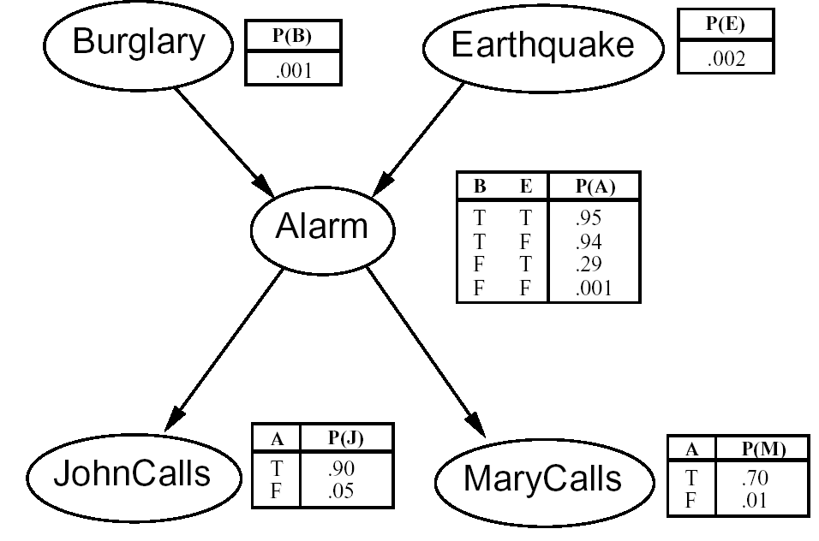
The network
I´m at work, John calls to say my alarm is ringing, Mary doesn´t call. Is there a burglary?
5 Variables
network topol-ogy reflects causal knowledge

Slide 15
4 Global and local semantics
Global semantics (corresponding to Halpern´s quantitative Bayesian network) defines the full joint distribution as the product of the local conditional distributions
For defining this product, a linear ordering of the nodes of the network has to be given: X₁ … X_{n}
μ(X₁ … X_{n}) = Π^{n}_{i=1} μ(X_{i}|Parents(X_{i}))
ordering in the example: B, E, A, J, M
μ(J ∩ M ∩ A ∩ ¬B ∩ ¬ E) =
μ(¬B)⋅ μ(¬ E)⋅μ(A|¬B∩¬ E)⋅μ(J|A)⋅μ(M|A)

Slide 16
Local semantics
Local semantics (corresponding to Halpern´s qualitative Bayesian network) defines a series of statements of conditional independence
Each node is conditionally independent of its nondescendants given its parents: I_{μ}(X, Nondescentents(X)|Parents(X))
Examples
  X →Y→ Z I_{μ} (X, Y) ? I_{μ} (X, Z) ?
  X ←Y→ Z I_{μ} (X, Z|Y) ?
  X → Y ← Z I_{μ} (X, Y) ? I_{μ} (X, Z) ?

Slide 17
The chain rule
μ(X, Y, Z) = μ(X) ⋅ μ(Y, Z |X) = μ(X) ⋅ μ(Y|X) ⋅ μ(Z| X, Y)
In general: μ(X₁, …, X_{n}) = Π^{n}_{i=1} μ(X_{i}|X₁, …, X_{i −1})
a linear ordering of the nodes of the network has to be given: X₁, …, X_{n}
The chain rule is used to prove
the equivalence of local and global semantics

Slide 18
Local and global semantics are equivalent
If a local semantics in form of the independeny statements is given, i.e.
I_{μ}(X, Nondescendants(X)|Parents(X)) for each node X of the network,
then the global semantics results:
μ(X₁ … X_{n}) = Π^{n}_{i=1} μ(X_{i}|Parents(X_{i})),
and vice versa.
For proving local semantics → global semantics, we assume an ordering of the variables that makes sure that parents appear earlier in the ordering: X_{i} parent of X_{j} then X_{i} < X_{j}

Slide 19
Local semantics → global semantics
μ(X₁, …, X_{n}) = Π^{n}_{i=1} μ(X_{i}|X₁, …, X_{i −1}) chain rule
Parents(X_{i}) ⊆ {X₁, …, X_{i −1}}
μ(X_{i}|X₁, …, X_{i −1}) = μ(X_{i}|Parents(X_{i}), Rest)
local semantics: I_{μ}(X, Nondescendants(X)|Parents(X))
The elements of Rest are nondescendants of X_{i}, hence we can skip Rest
Hence, μ(X₁ … X_{n}) = Π^{n}_{i=1} μ(X_{i}|Parents(X_{i})),

Slide 20
5 Constructing belief networks
Need a method such that a series of locally testable assertions of
conditional independence guarantees the required global
semantics
Chose an ordering of variables X₁, …, X_{n}
For i = 1 to n
add X_{i} to the network
select parents from X₁, …, X_{i −1} such that
μ(X_{i}|Parents(X_{i})) = μ(X_{i}|X₁, …, X_{i −1})
This choice guarantees the global semantics:
μ(X₁, …, X_{n}) = Π^{n}_{i=1} μ(X_{i}|X₁, …, X_{i −1}) (chain rule)
= Π^{n}_{i=1} μ(X_{i}|Parents(X_{i})) by construction

Slide 21
Earthquake example with canonical ordering
What is an appropriate ordering?
In principle, each ordering is allowed!
heuristic rule: start with causes, go to direct effects
(B, E), A, (J, M) [4 possible orderings]

Slide 22
Earthquake example with noncanonical ordering
Suppose we chose the ordering M, J, A, B, E
μ(J|M) = μ(J) ?
μ(A|J,M) = μ(A|J) ? μ(A|J,M) = μ(A) ?
μ(B|A,J,M) = μ(B|A) ?
μ(B|A,J,M) = μ(B) ?
μ(E|B, A,J,M) = μ(E|A) ?
μ(E|B,A,J,M) = μ(E|A,B) ?
MaryCalls
JohnCalls
Alarm
Burglary
Earthquake
No
No
Yes
No
No
Yes

Slide 23
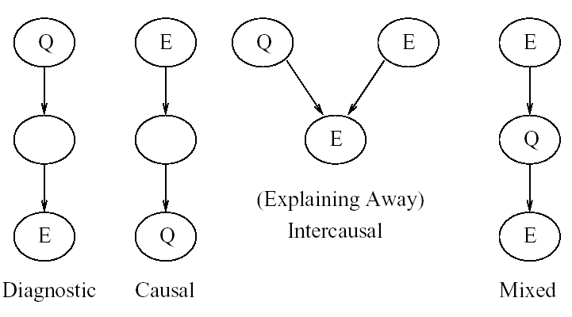
6 Inference in belief networks
Types of inference:
Q quary variable, E evidence variable

Slide 24
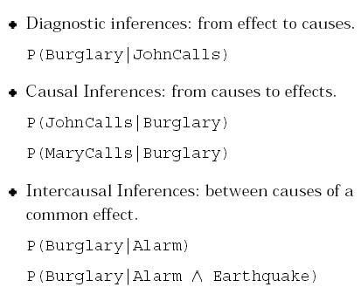
Kinds of inference

